Slide 1

BLOOD CANCER DETECTION USING MACHINE LEARNING
Department of Computer Science (Non AICTE)
RCC Institute of Information Technology
Canal South Road, Beliaghata, Kolkata-700015
Under Supervision of Mr. Falguni Adhikary, Dept. of CS, RCCIIT
Presented by
PRERNA KUMARI SHAW [University Roll :37701221005]
TUNIR DUTTA
[University Roll : 37701221013]

Slide 2
Introduction
Blood cancer, also known as hematologic cancer, it is a broad category of highly differentiated cancers that impact the bone marrow, which produces blood cells, as well as the blood itself.
To achieve this by leveraging machine learning algorithms, specifically Random Forest (RF), k-Nearest Neighbors (KNN), and Support Vector Machines (SVM). Our proposed model will be deployed to analyze comprehensive data pertaining to various parameters of normal blood cells, including white blood cells, red blood cells, and platelets.

Slide 3
Motivation
The motivation behind this project is deeply rooted in the pressing need for advancements in blood cancer diagnostics, which has served as the driving force propelling our research and development efforts.
Our project's focus on machine learning provides a unique learning opportunity for individuals and institutions involved. It encourages the exploration of novel techniques and methodologies, fostering a culture of innovation and adaptability within the healthcare and data science communities.

Slide 4
Literature Review
Puneet , Anamika Chauhan. “ Supervised detection of Lung cancer using Machine learning techniques based on routine blood indices” In 2020 IEEE International Conference for Innovation in Technology (INOCON)Bengaluru, India. Nov 6-8, 2020.
R. Duggal, A. Gupta, and R. Gupta, "Segmentation of overlapping/touching white blood cell nuclei using artificial neural networks" CME Series on Hemato-Oncopathology. All India Institute of Medical Sciences (AIIMS), New Delhi, India, July 2016.
S. Kumar, S. Mishra, P. Asthana," Automated Detection of AcuteLeukemia Using K-mean Clustering Algorithm". InAdvances inComputer and Computational Sciences. 2018, pp. 655-670
Tomasz Markiewicz, Stanislaw Osowski, Bonenza Marianska, and Leszek Moszczynski. Automatic recognition of the blood cells of myelogenous leukemia using svm. In Proceedings. 2005 IEEE International Joint Conference on Neural Networks, 2005., volume 4, pages 2496-2501.IEEE, 2005

Slide 5
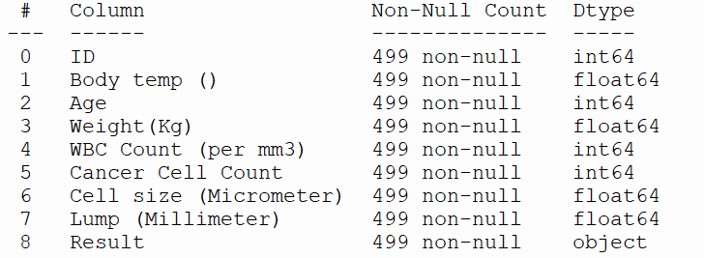
Dataset
Our dataset has more than 500 data with eight parameters which are used in the dataset. The parameters are used here which is to be predicted as object data type. Datasets represents different types of symptoms found in the patients in India.

Slide 6
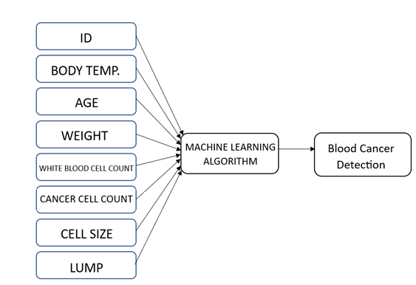
Problem Analysis

Slide 7
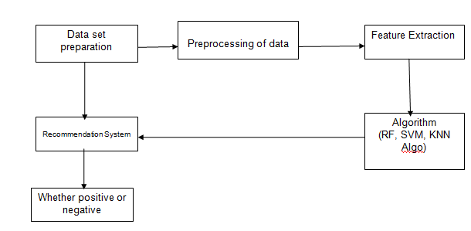
Proposed Model

Slide 8
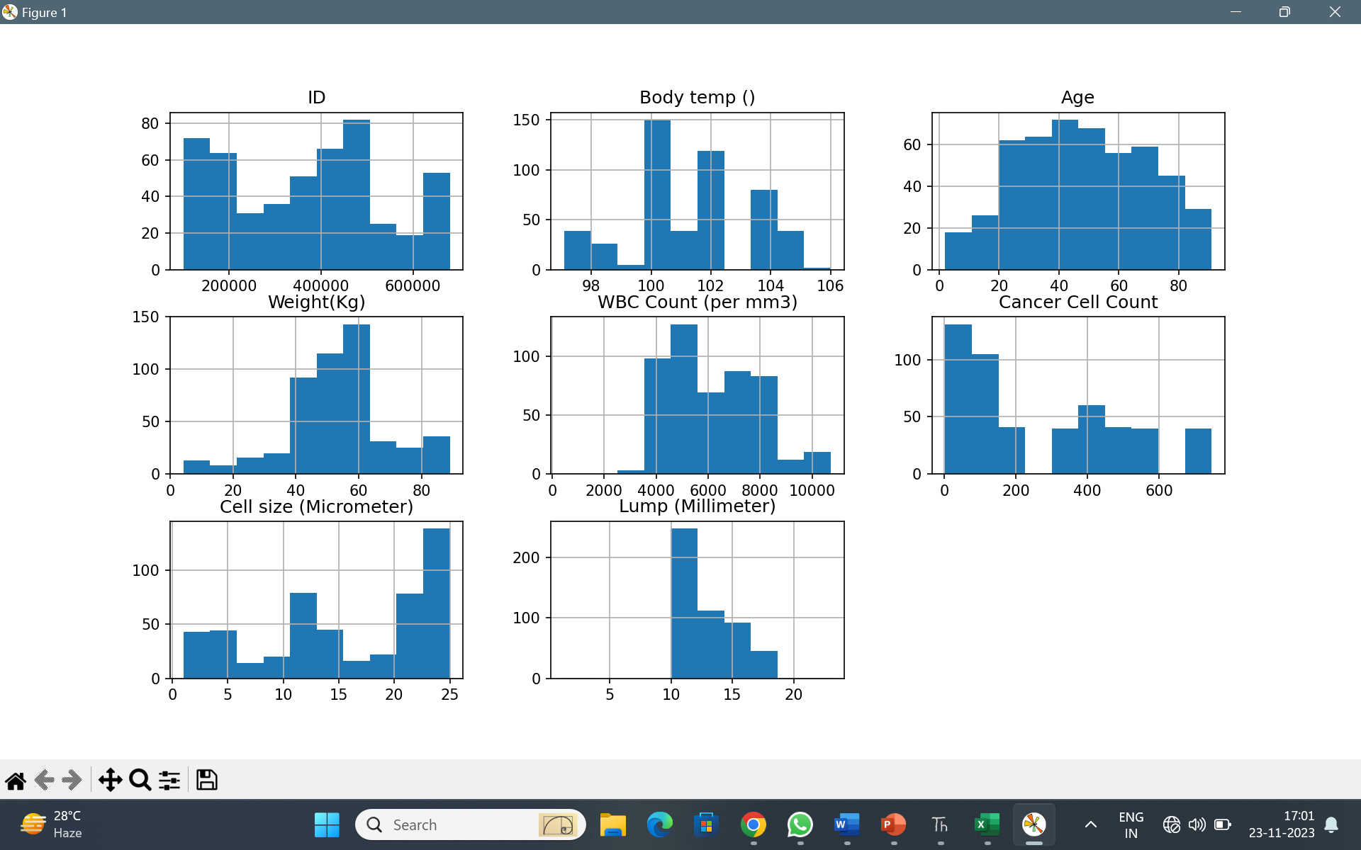

Histogram Presentation

Slide 9
Classification of Model Building
K-Nearest Neighbor
K-Nearest Neighbour is one of the simplest Machine Learning algorithms based on Supervised Learning technique. K-NN algorithm assumes the similarity between the new case/data and available cases and put the new case into the category that is most similar to the available categories. K-NN algorithm stores all the available data and classifies a new data point based on the similarity.
Random Forest Classifier
RF algorithm selects random sample from training dataset. Then it will construct decision tree. After that each result is predicted considering voting. Final prediction will be done based on most voting result.
SVM Classifier
SVM is concerned with binary data classification. Basis on seven parameters, SVMs determines whether crops can grow in that area. This method creates a large plane in N-dimensional space, where N is the number of features that will be used to describe the content of the data in the dataset

Slide 10
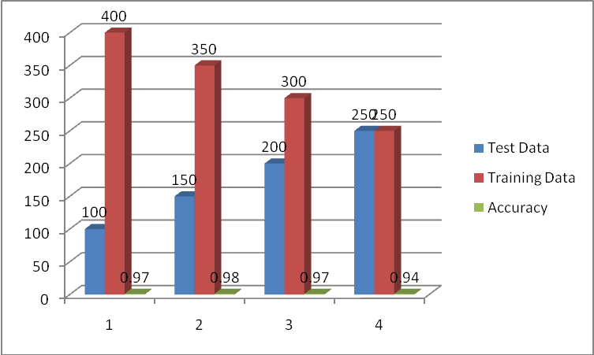
Random Forest

Slide 11
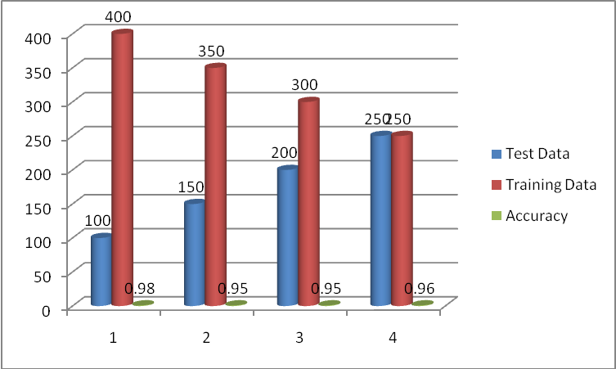
Support Vector Machine

Slide 12
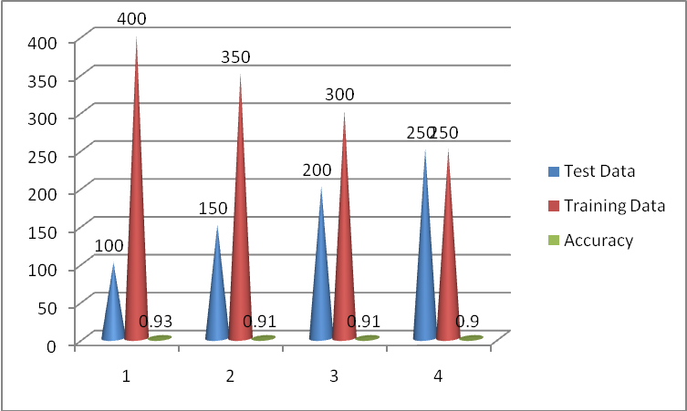
k-Nearest Neighbors

Slide 13
Comparison of accuracy using classifier
RF | SVM | KNN
0.97 | 0.98 | 0.93
0.98 | 0.95 | 0.91
0.97 | 0.95 | 0.91
0.94 | 0.96 | 0.9
0.965 | 0.96 | 0.9125

Slide 14
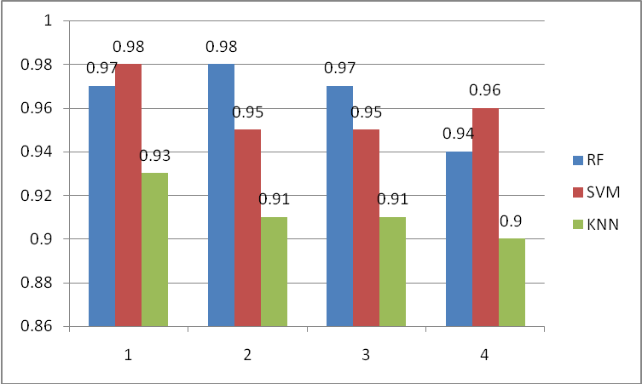
Accuracy of RF & SVM

Slide 15
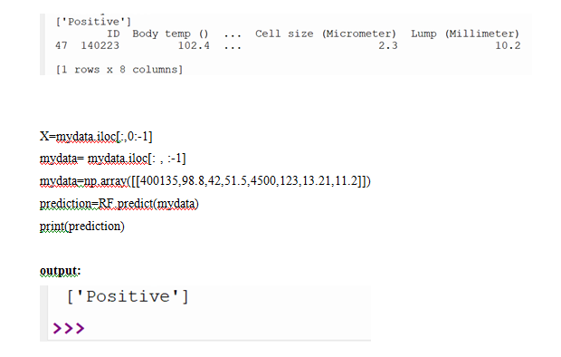
Detection of the blood cancer

Slide 16
Conclusion & Future Scope
The project focused on enhancing early detection of blood cancer has marked significant progress in leveraging machine learning algorithms—Support Vector Machines (SVM), Random Forest, and k-Nearest Neighbors (KNN). These algorithms were employed to predict blood cancer status based on patient parameters like body temperature, weight records, cell counts, and other relevant factors.
Ultimately, this project lays the groundwork for leveraging machine learning algorithms in early detection efforts for blood cancer. Future endeavors in this direction have the potential to substantially advance healthcare practices, benefiting individuals at risk of blood cancer and contributing to better public health outcomes.

Slide 17
Reference
Puneet , Anamika Chauhan. “ Supervised detection of Lung cancer using Machine learning techniques based on routine blood indices” In 2020 IEEE International Conference for Innovation in Technology (INOCON)Bengaluru, India. Nov 6-8, 2020.
R. Duggal, A. Gupta, and R. Gupta, "Segmentation of overlapping/touching white blood cell nuclei using artificial neural networks" CME Series on Hemato-Oncopathology. All India Institute of Medical Sciences (AIIMS), New Delhi, India, July 2016.
S. Kumar, S. Mishra, P. Asthana," Automated Detection of AcuteLeukemia Using K-mean Clustering Algorithm". InAdvances inComputer and Computational Sciences. 2018, pp. 655-670
Tomasz Markiewicz, Stanislaw Osowski, Bonenza Marianska, and Leszek Moszczynski. Automatic recognition of the blood cells of myelogenous leukemia using svm. In Proceedings. 2005 IEEE International Joint Conference on Neural Networks, 2005., volume 4, pages 2496-2501.IEEE, 2005

Slide 18
Thank You

